Slide 1


EASY RENTAL
Team -124
Find your Home away from Home
Vaibhav Sethia (E19CSE321)
Dharmendra Sankhla (E19CSE353)
Mentor- Dr. Tapas Badal
CSE Department

Slide 2
TABLE OF CONTENTS
01
04
02
05
03
06
About the Project
Proposed System
Introduction
Market Giants
Problems
Project Setup

Slide 3
TABLE OF CONTENTS
07
10
08
11
09
123
Sneak Peek
Results
Tech Stack Used
Learning Outcomes
Project Breakup
Conclusion & Future work

Slide 4
Easy Rental
ABOUT THE PROJECT
71 Mn of children in India attend private coaching classes
40 Mn of employees migrate to other state in pursuit of job
Look out for an affordable home on rent
Pay 10-15% commission to broker

Slide 5
Introduction
Easy Rental – platform for renting and co-housing
Connects Host with Guest
Hosts earn money by listing rentals
Tenants enjoy savings
Broker ✗
Strategically located ✓
Good quality ✓
Affordable housing ✓
Ease of Living ✓

Slide 6
PROBLEMS
Unfair denial of bachelors − Fear of involving in illicit activities
No Long term accommodation − Expensive housing
Dealing with Brokers − 10-15% of rent as brokerage

Slide 7
PROPOSED SOLUTION
Meticulously designed to focus on user demands
Choose from list of rooms based on ratings and reviews
Owners list their property provide the description, rent, feature, and images
Tenants search houses, add them to their wish list or make a booking
Host has an option to accept/decline booking
Thus, eliminating the need for a broker

Slide 8

User Case Diagram
Well, Grandpa has moved to the U.S, and now who will look after the villa? Let’s see if one is interested to stay there.
Nowadays work is so hectic! Traveling from town takes 2 hrs. I am not getting time for family. Hope I get a villa on rent near the office.

Slide 9
Face off with Market Giants
NoBroker is the biggest competitor
70% of the revenue comes from subscription plan
Nest Away and Your Own Room charge 12.5% on each rental agreement
Smart LiveIn charges hefty 35% on fully furnished houses
Easy Rental shows rentals of super host at no extra cost
No commission for any rental agreement
Affordable housing for the tenants
Longer accommodation period available.

Slide 10
PROJECT SETUP
Download Easy Rental repo − From https://github.com/VaibhavSethia07/Easy-Rental
Create virtual environment − In the root directory run the command pipenv shell to activate the virtual environment through command line.
Install Python, pip & pipenv −
sudo apt-get update
sudo apt-get install python3.6
sudo apt install python3-pip
pip install --user pipenv
Install Django − sudo apt install python3-django
Run the local host server − Run python manage.py runserver to run the localhost server.
Go to website − http://127.0.0.1:8000/

Slide 11
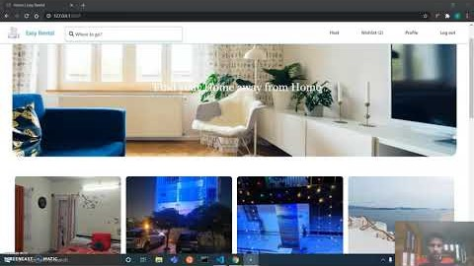
SNEAK PEEK
Let’s look how Easy Rental works!

Slide 12



Tech Stack Used
01
02
03
Django
Python framework for rapid development
TailwindCSS
Utility first framework for smooth and sleek website flow
Gulp
To add custom animations, sizes and reuse of CSS classes

Slide 13
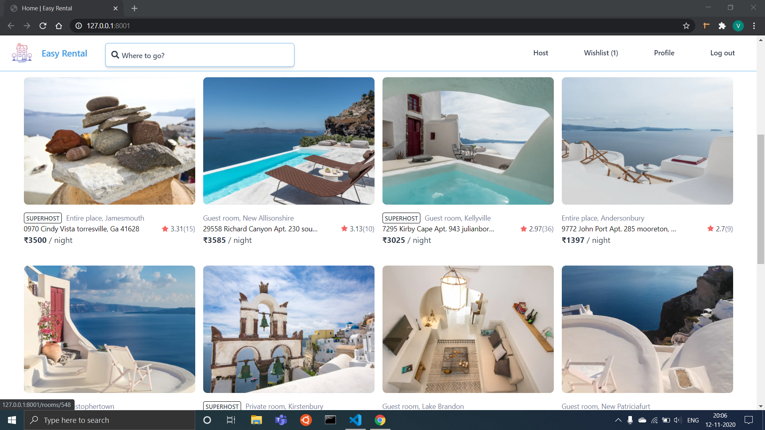
A PICTURE ALWAYS REINFORCES THE CONCEPT

Slide 14
PROJECT BREAKUP
Signup/login, profile name, avatar, gender, bio, birthdate & super host
Calendar date pickup, confirm or cancel pending booking
Users
Reservations
Rooms
Reviews
Conversations
Name, description, address, photos, price & room type
Stay review, ratings on cleanliness, location, accuracy &communication
Messaging between host & tenant

Slide 15
RESULTS
1.
2.
3.
4.
Eliminated the need for a broker between the owner and tenants.
Searching houses and booking is smooth & easy.
Adding & updating the property info. such as location, services, photos, & description is possible
Saves 10 − 15% of rent for the tenant

Slide 16
LEARNING OUTCOMES
27%
70%
52%
Configuring admin view
Django templates & views
Panel for programmers to act as the super user
Rendering HTML sufficed templates on web
Intercepting save mode
URLs & Arguments
Used to make changes in Django model fields before saving
Work on URL patterns
for routing and use request argument to return response

Slide 17

FUTURE WORK
2020
2022
2024
2026
2028
Geo-location using Google Maps for accuracy
Home style food service for tenants to satisfy nutritional needs
Payment integration using Stripe for booking

Slide 18
CONCLUSION
User centric approach
Quick rental hosting
Eliminating brokers
Efficient search and reservation process
Owner describes the property with the least amount of effort
Seamless workflow from logging, to booking to leaving review

Slide 19
OUR TEAM
DHARMENDRA SANKHLA
VAIBHAV SETHIA
E19CSE353
E19CSE321

Slide 20
THANKS
Do you have any questions?
For more information
Medium
YouTube
GitHub
Please keep this slide for attribution.

